Slide 1
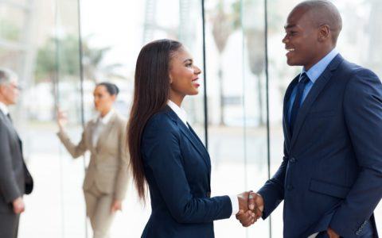

Dressing for Success
The Primera MFB Way

Slide 2
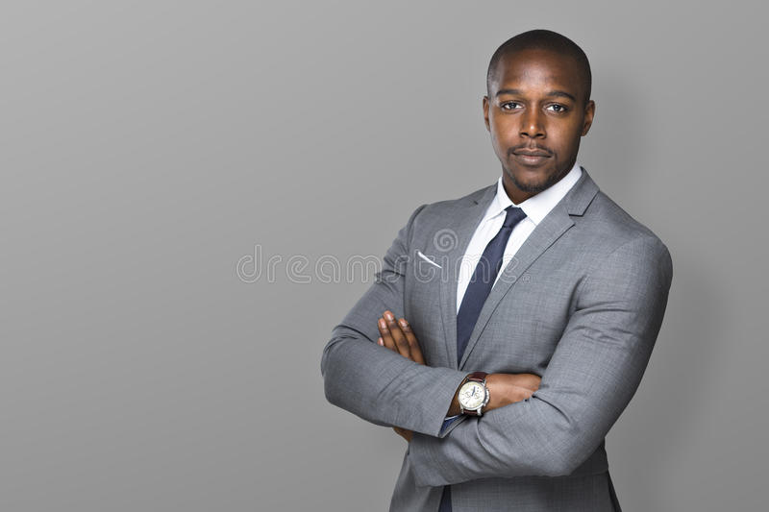

Introduction
The dress code of Primera MFB requires that employees are to be suitably dressed to demonstrate a professional appearance and to reflect the spirit of the organization.
Primera MFB does not seek to inhibit individual choice in relation to your appearance. However, you are expected to dress appropriately at all times and ensure that your personal hygiene and grooming are properly attended to prior to presenting yourself at work.
Increase your Personal Brand Value with your Dress Outlook

Slide 3
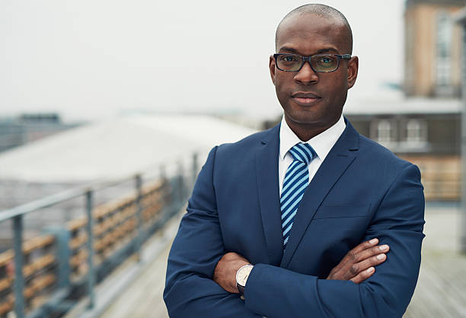
Office Dress Code

Slide 4
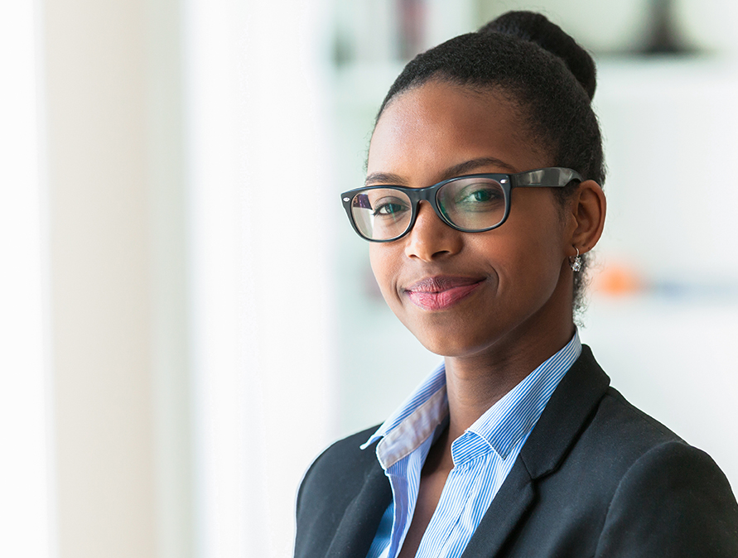
Dress Code- Monday- Friday
Monday – Thursday: Formal or business style dressing.
Friday: Business/Smart Casual (Including Native).
Branded T shirts can be worn with Jeans ( No ripped or Tattered jeans are allowed)
As a general rule, casual dressing is not allowed. This includes the wearing of Jeans, Denim tops. Jeggings, Three quarter trousers, Boubous, Wrappers and Casual slippers.
A good guide is to consider your appropriateness to meet with clients or business associates both outside or within the organisation.
4

Slide 5
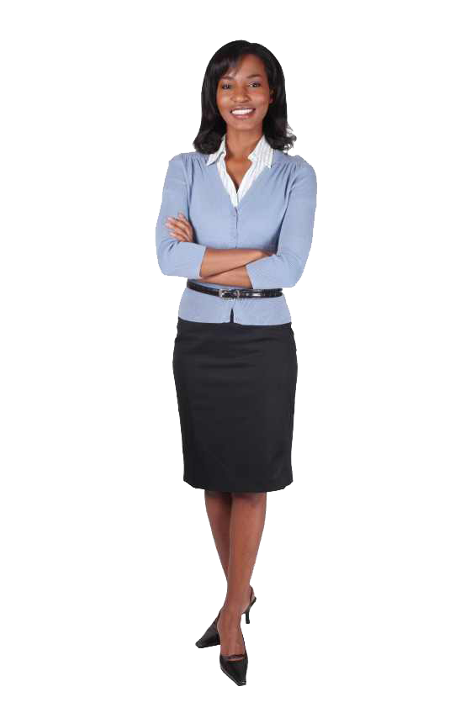
Examples Of Business Style Dressing- Female Staff
A classic suit (Corporate Suit) for the Ladies. Any color would do but not too brightly colored. Suits, blazers, buttoned down sweaters with a skirt or dress should be conservative and below knee length.
Blouses should be simple in style, white or soft colors.
Trousers ,skirts, corporate dresses are also appropriate. Tight trousers and skirts as well as short skirts and dresses are not allowed.
Business casual belts should be compatible or coordinate with the other items that you are wearing.
Classic leather pumps, Open toes, and flats still mean business with tailored looks. Female staff should take note of shoes and colours that are party like e.g Gold, Champagne, Silver, Orange and turquoise colours that are inappropriate for an official look.

Slide 6
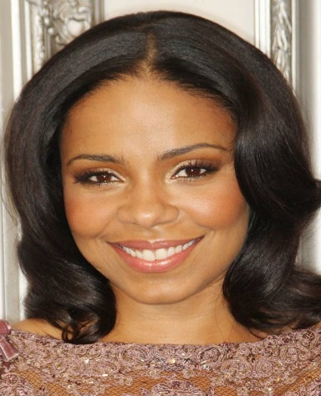
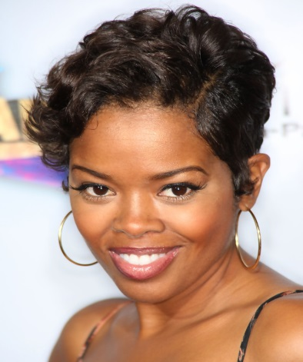
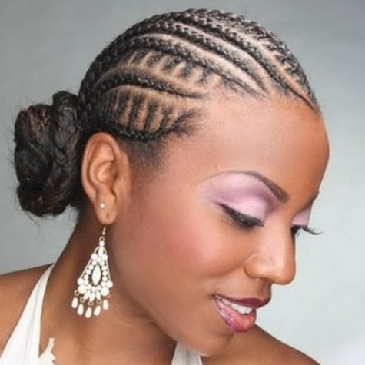
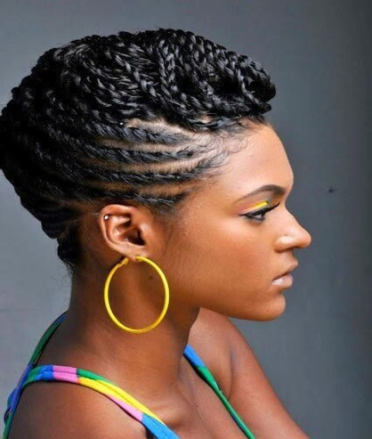
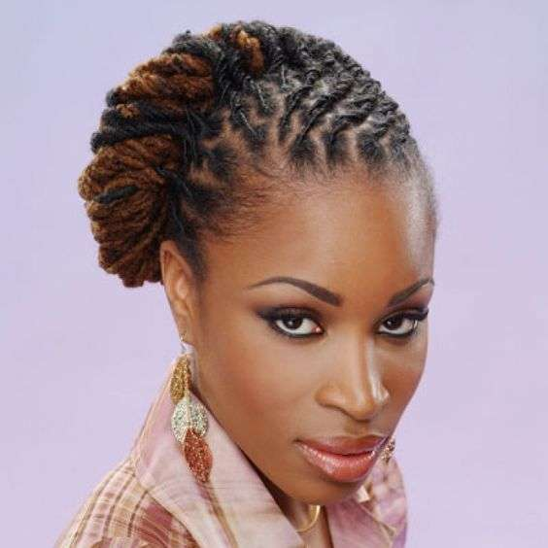
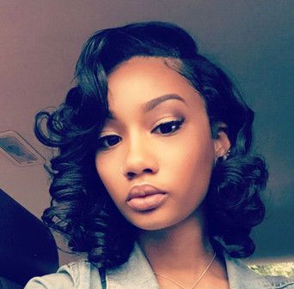
Hair Style , Make Up And Fingernails And Jewelry
Ladies are to maintain hairstyles that will enhance their business wardrobe. Hairstyles should be neat and give a corporate outlook.
Make-up should not be excessively loud.
Ladies nails should be as well maintained as they are on business professional days.
Jewelry should be same as worn on business professional days. Jewelry should be simple.

Slide 7
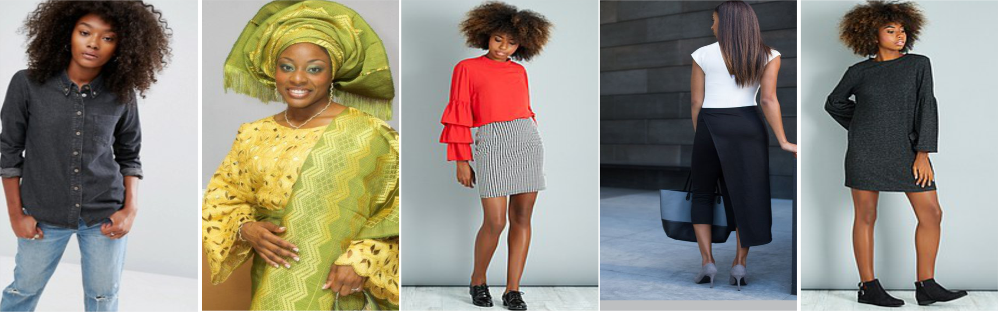
Outfits That Are Not Allowed – Female Staff
Wearing skirts, trousers and dresses that are too short and tight.
Wearing sleeveless or halter tops and see-through blouses.
Wearing stretch pants.
Rumpled or stained clothing.
As a general rule, casual dressing is not allowed. This includes the wearing of Jeans, Denim Tops or Jeggings, Three quarter trousers, printed trousers, Boubous, Wrappers and Casual slippers, T-shirts , denim Tops .

Slide 8

Examples Of Business Style Dressing- Male Staff
Suits- Dark blue, Black , grey, pin-stripes.
Shirts- White, pale blue, simple and not overly bright colours.
Tie- Conservative.
Shoes- Well polished and covered shoes.
Male staff should be clean shaven. Beards should be kept low and well groomed.

Slide 9
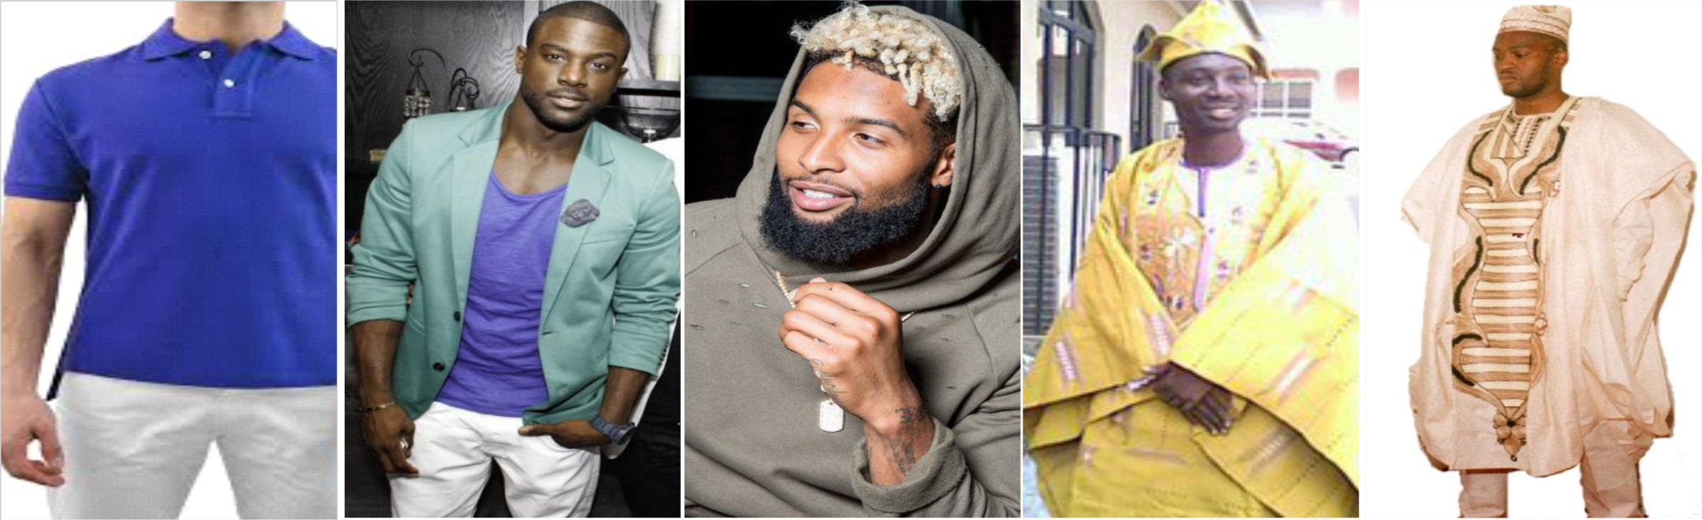
Outfits That Are Not Allowed- Male Staff
Short-sleeved shirts are not allowed on business suits.
Rumpled or stained clothing.
The length of the ties should not be short.
Overly bright or large-patterned shirts and ties.
Wearing of palm slippers with traditional outfits on Fridays.
9

Slide 10
Dress Style
DRESS STYLES - EXAMPLES
Examples
10

Slide 11
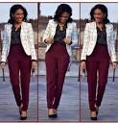
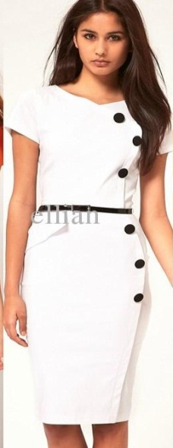
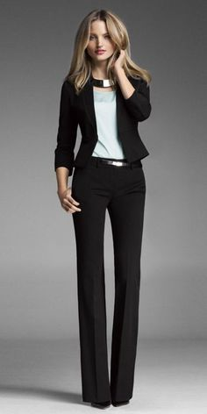
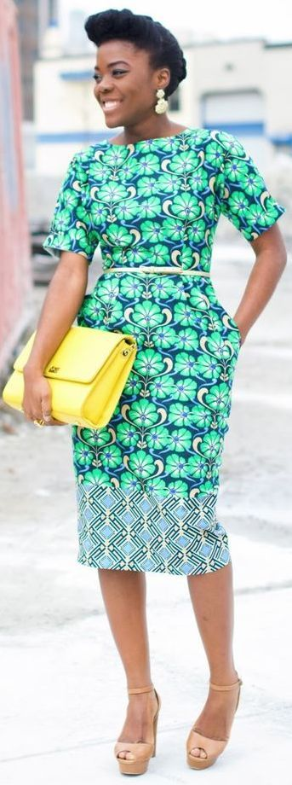
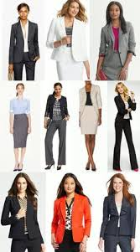
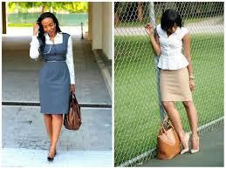
Appropriate Dress Styles – Female Staff
11

Slide 12
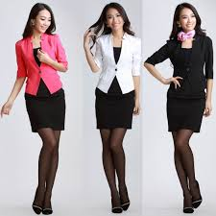
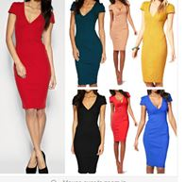
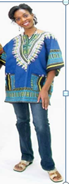
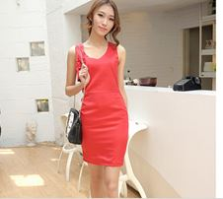
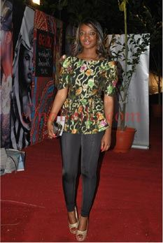
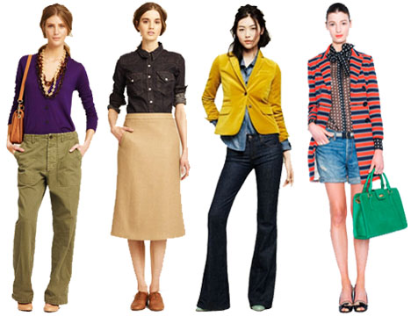
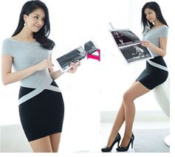
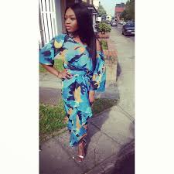
Inappropriate Style Of Dressing – Female Staff

Slide 13
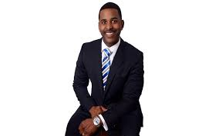
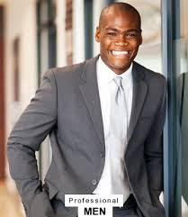
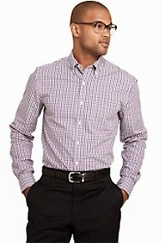
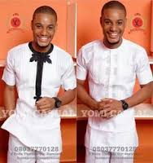
Appropriate Dressing- Male Staff

Slide 14
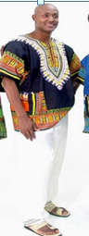
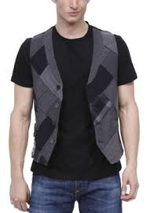
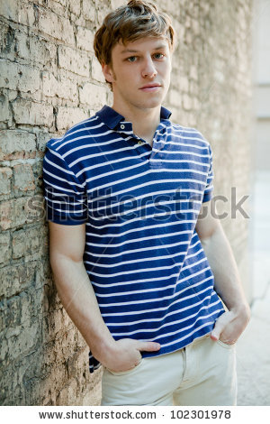
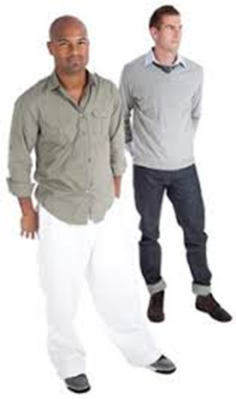
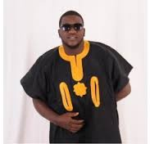
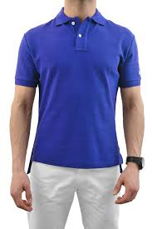
Inappropriate Dressing- Male Staff

Slide 15
